Slide 1

VISVESVARAYA TECHNOLOGICAL UNIVERSITY, BELAGAVI-590018
Govt. Engineering College, Chamarajanagara -571313
Dept. of Computer Science & Engineering
Major Project Work Presentation on
“BugBuster IDE”
Under the Guidance of
Prof. SUREKHA V
Presenting By
A M Chethan 4GE22CS001
Gagan G 4GE22CS014
Somesh N M 4GE22CS037
Thejesh kumar T L 4GE22CS042
Head of Department
Dr. Shyleshchandra K Gudihatti
Associate professor

Slide 2
Abstract
The BugBuster IDE is a web-based, multi-language development environment that enhances coding efficiency. It accepts source code into a secure, Dockerized platform. The core process uses the DeepSeek-Coder model to analyze code structure and context, detecting subtle logical errors missed by traditional tools. The output provides clear error visualization and automated, accurate code corrections, offering a smarter and more productive development pathway.

Slide 3
Introduction
Existing IDE’S Students and beginners often struggle to identify and correct bugs in their code. Manual debugging takes more time, requires experienced knowledge, and is error-prone. Existing tools provide either basic syntax checks or are too advanced/complex for beginners. No simple platform that gives instant feedback, auto-correct suggestions, and error explanations in one place.
Bug Buster supports multiple languages (like Python, C, Java, javascript, C sharp, CPP – customizable).Identifies syntax, semantic, and logical errors quickly. Provides corrected code suggestions, and tips to avoid similar mistakes. Reduces debugging time and helps users learn from their mistakes. User-friendly interface with fast processing, making it ideal for academic use.

Slide 4
Problem Statement
BugBuster is an intelligent, cross-language system that uses the Deepseek-Coder model to detect bugs and automatically correct errors in real time.

Slide 5
Scope of the Project
Web-based IDE for multi-language coding (Python, Java, C, C++, JS, etc.)
AI-powered features: auto-detect & correct syntax, semantic, and logical errors
Panels for file management, code editing, output, and error messages
Secure program execution via Dockerized compilers

Slide 6
Objectives
Automated Error Detection
Automated Code Correction
Support Multiple Language

Slide 7
Requirements
Software Requirements
Frontend: React.js with Monaco Editor
Backend: FastAPI (Python)
AI/ML Models: LLMs for autocorrection
Containerization: Docker (with compiler images for Python, C, C++, Java, etc.)
OS Support: Windows, Linux, macOS (browser-based access)
Browser Support: Chrome, Firefox, Edge
Hardware Requirements
Server/Deployment:
Processor: Quad-Core (Intel i5 / AMD Ryzen 5 or higher)
RAM: 8 GB minimum
Storage: 256 GB SSD or more
Internet: Stable broadband for real-time execution and model API calls
Client (User System):
Processor: Dual-Core (Intel i3 / AMD equivalent or higher)
RAM: 4 GB minimum (8 GB recommended for smooth usage)
Storage: 50 GB free space
Internet: Minimum 5 Mbps for IDE access and code execution

Slide 8
Literature Survey
Paper Name | Authors | Year | What the Paper Does | Algorithms Used | How BugBuster is Better | Algorithms in BugBuster
ChatDBG | Kyla Levin et al. | 2025 | Interactive debugging using LLMs with control over tools like GDB, LLDB. | LLM-powered interactive control | BugBuster detects the errors and automatically fixes the errors in real time . | Deepseek-coder model, RNN algorithm
DeepCode AI Fix | Berkay Berabi et al. | 2024 | Fixes security vulnerabilities using LLMs + static analysis and code reduction. | LLMs, Static Analysis | Handles broader bug types, supports real-time multi-language debugging. | GNNs, AST analysis, Transformer models, Codex, GPT, Isolation Forests
AI-enhanced Auto-correction of Programming Exercises | Imen Azaiz et al. | 2023 | Uses GPT-3.5 to give personalized feedback and auto-correct student code. | GPT-3.5 | BugBuster covers full bug lifecycle, with real-time correction. | Transformer models, RL, ML classifiers, program slicing
AI Code Review | Yonatha Almeida et al. | 2024 | Enhances code review with GPT-3.5 plugin in IntelliJ to detect syntax/semantic issues. | GPT-3.5 | BugBuster automates error fixing and code generation, not just suggestions. | Seq2Seq, NMT, GenProg, SemFix, dynamic analysis
From Code to Correctness (MGDebugger) | Yuling Shi et al. | 2024 | Hierarchical debugging for LLM-generated code using MGDebugger. | Multi-Granularity Debugger | BugBuster performs debugging and also handles generation and correction. | GenProg, Nopol, Deep Learning models, RL, test suites

Slide 9
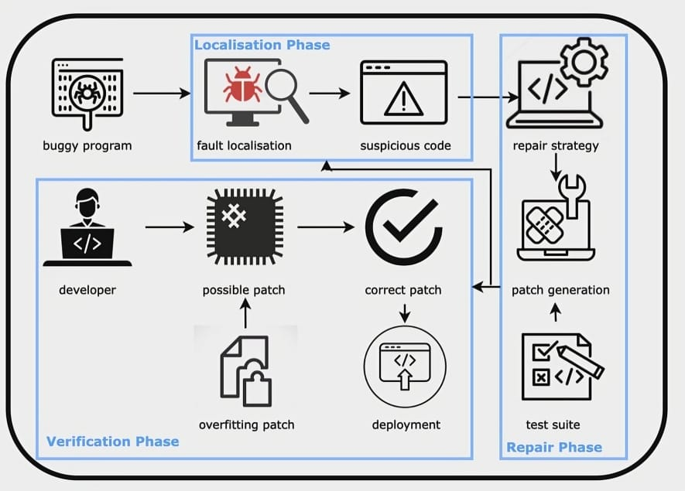
Design and Architecture

Slide 10
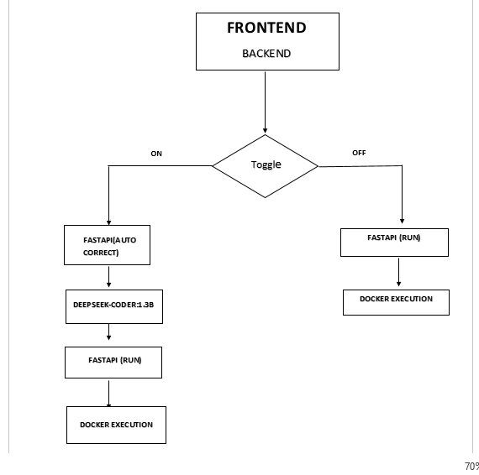
Data Flow Diagram

Slide 11
Localization Phase
Fault Localization
Syntax Analysis
Lexer + Parser (AST Construction)
Lexer: Reads code letter by letter and splits it into tokens (keywords, operators, identifiers).
Parser: Uses those tokens to check if the code follows the grammar rules.
Builds an Abstract Syntax Tree (AST) → a tree structure that shows the code’s structure.
If rules are broken (e.g., missing semicolon, wrong bracket) → syntax error.

Slide 12
Semantic Analysis
Dataflow Analysis and Type Checking
Dataflow Analysis :Tracks data flow (e.g., variable definitions and uses) to detect issues like uninitialized variables. Builds a Control Flow Graph (CFG) to map program flow.
Type Checking : Verifies type compatibility to catch type-related semantic errors. Constructs an Abstract Syntax Tree (AST) from parsed code. Traverses the AST to infer or check types based on language rules, reporting errors when operations or assignments involve incompatible types.

Slide 13
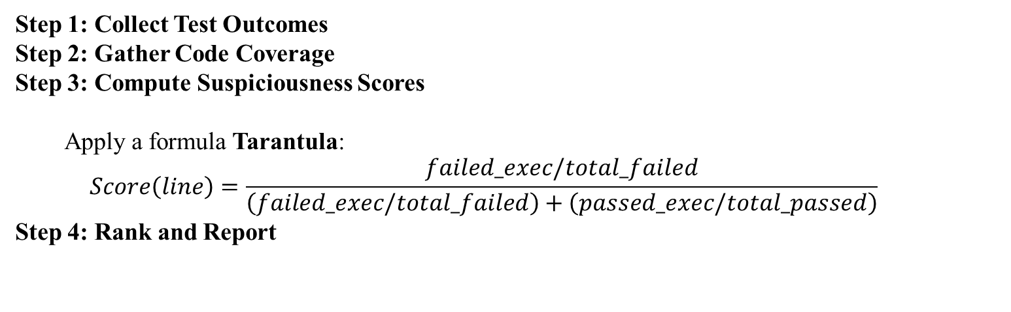
Logical analysis
Spectrum-Based Fault Localization (SBFL)
Spectrum-based fault localization (SBFL) is a technique that identifies the likely location of logical errors (bugs causing incorrect program behavior) by analyzing how code is executed across passing and failing test cases. It ranks code elements (e.g., lines or statements) based on their association with failures, helping developers pinpoint faults efficiently.
Step 1: Collect Test Outcomes
Step 2: Gather Code Coverage
Step 3: Compute Suspiciousness Scores
Apply a formula Tarantula:
$$Score\left(line\right)=\frac{failed_exec/total_failed}{\left(failed_exec/total_failed\right)+\left(passed_exec/total_passed\right)}$$
Step 4: Rank and Report

Slide 14
Repair phase
Repair strategy
A repair strategy is the systematic approach used to fix the suspicious code flagged during fault localization. It decides how to modify the faulty lines, tests the modifications, and selects the one that produces correct results.
Strategy Type | How it works | Example
Pattern-based | Uses predefined fix patterns from previous bugs. | Replace == with != for conditional checks, or change i <= n to i < n to fix off-by-one errors.
Search-based | Systematically tries multiple edits using rules or algorithms. | Swap operators, change variables, insert/remove statements, then test each candidate.
AI-based (ML/LLM) | Uses machine learning or language models to predict the correct code. | LLM suggests the next line or replacement for the buggy line based on learned code patterns.
Semantic-based | Uses program semantics, like data flow, type checking, or constraints, to generate meaningful fixes. | Ensure that a variable is not null before use; adjust loops based on program invariants.

Slide 15
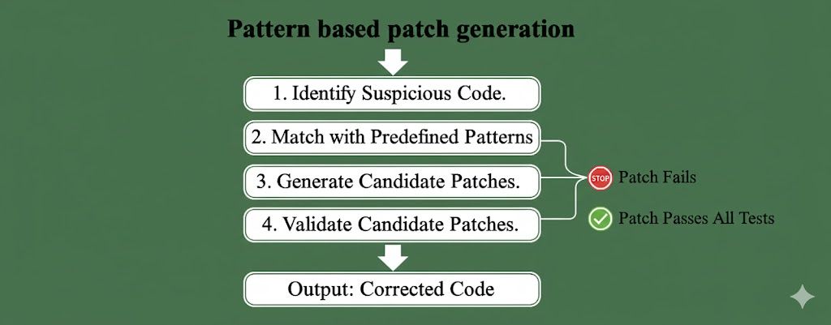

Slide 16
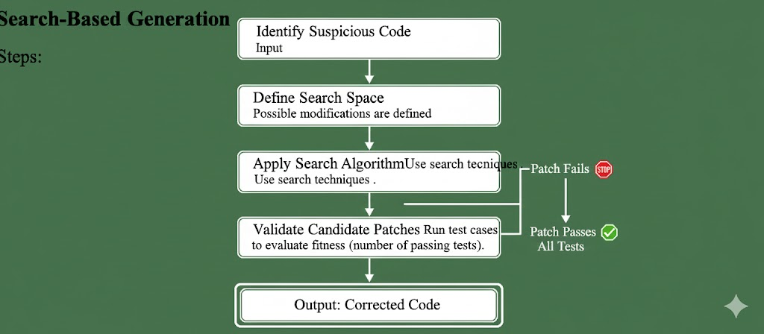

Slide 17

.

Slide 18
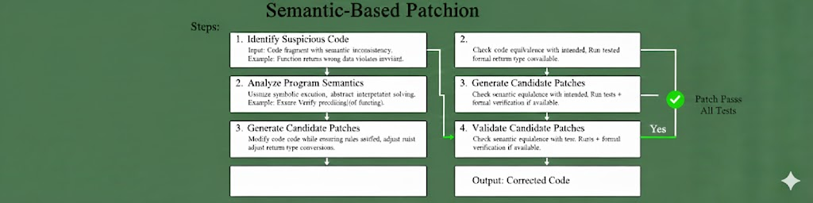

Slide 19
Test suite
Purpose: The test suite contains all the test cases that the program must pass.
Function: It is used to validate candidate patches generated for the buggy code.
How it works:
The repair system applies potential fixes to the suspicious code.
Each candidate fix is tested against the test suite.
Only patches that pass the required tests are considered valid.
Goal: Ensure that the patch fixes the bug without introducing new errors.

Slide 20
Verification Phase
After patch generation, each candidate patch is tested against the program’s test suite.
Steps involved:
1. Run failing test cases.
2. Run regression tests
3. Patch validation.
4. Patch selection.

Slide 21
Deployment
After verification, the final validated patch is ready to be deployed into the main program.
Steps in Deployment:
1. Patch Integration.
2. Build & Compile
3. Final Testing .

Slide 22
IMPLEMENTATION
1. Frontend Implementation
The frontend is implemented as a responsive, browser-based IDE that enables users to create, edit, run, and debug code across multiple programming languages.
Technologies
React.js
Monaco Editor (VS-Code compatible)
TailwindCSS
Features
File Management Panel Users can create, rename, delete, and switch between files.
Code Editor Panel Implements syntax highlighting, formatting, and multi-language support (C, C++, Python, Java, JavaScript, C#, etc.).

Slide 23
3. User Interface Controls
Theme switching (Dark/Light)
AutoCorrect toggle (ON/OFF)
Language selection
Run button for execution
4. Output and Messages Panel Displays:
Program output
Runtime errors
AI suggestions
Execution logs
The frontend communicates with the backend through REST APIs exposed by FastAPI.

Slide 24
Backend Implementation
The backend is built using FastAPI, providing high-speed asynchronous processing of user requests.
Responsibilities
Receive source code from the frontend
Identify language and execution mode
Check AutoCorrect toggle status
Manage model inference (DeepSeek-Coder 1.3B)
Initiate execution pipeline through Docker
Collect output and return response

Slide 25
AI-Assisted Error Detection & Correction
Bug Buster integrates the Deepseek-Coder 1.3B model to enable automated syntax and semantic correction.
Workflow
When AutoCorrect is ON:
Code is sent to inference module
Model performs:
Syntax parsing
Semantic validation
Logical reasoning
Patch generation
The corrected code is returned to backend
The corrected code replaces original source temporarily

Slide 26
Execution Environment
To ensure secure, deterministic, and isolated execution of user code, BugBuster uses Docker containers.
Execution Steps
Backend passes source code to appropriate container
Container compiles/executes code
Captures stdout, stderr, exit status
Sends results to backend
Backend returns formatted output to UI

Slide 27
Toggle-Based Execution Logic
BugBuster implements a conditional execution pipeline based on the AutoCorrect toggle.
Case 1: AutoCorrect ON
Code sent to FastAPI
FastAPI sends to DeepSeek-Coder
Model returns corrected version
Backend forwards to Docker
Docker executes corrected code
Output rendered to UI
Case 2: AutoCorrect OFF
Code sent directly to Docker
Docker executes original code
Output rendered to UI

Slide 28
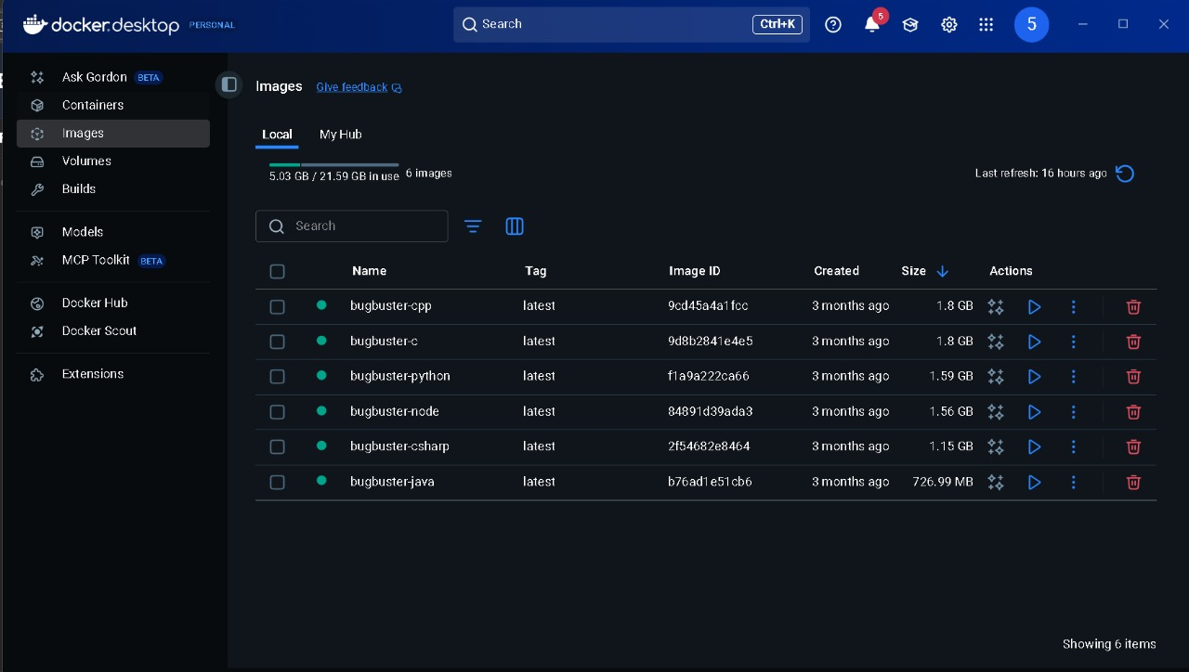
SNAPSHOT

Slide 29
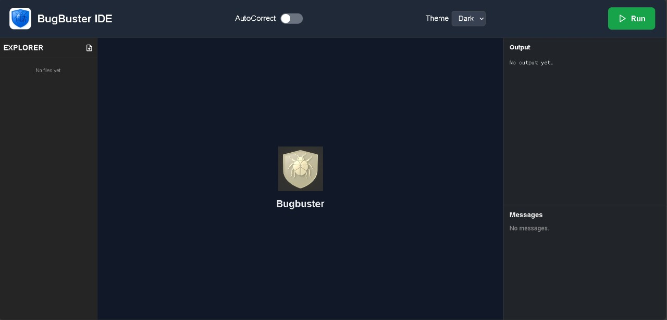

Slide 30
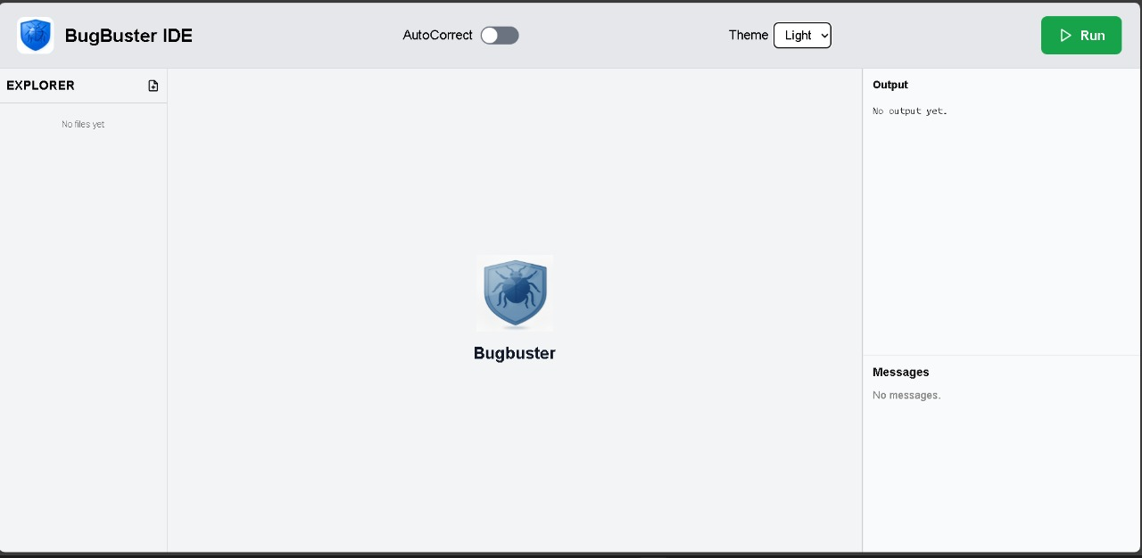

Slide 31
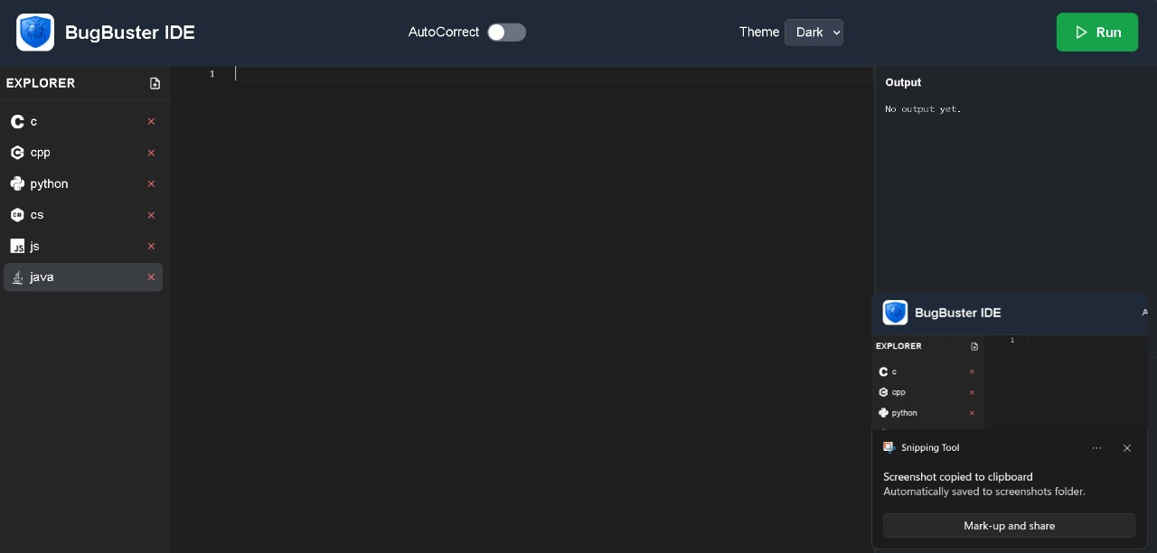

Slide 32
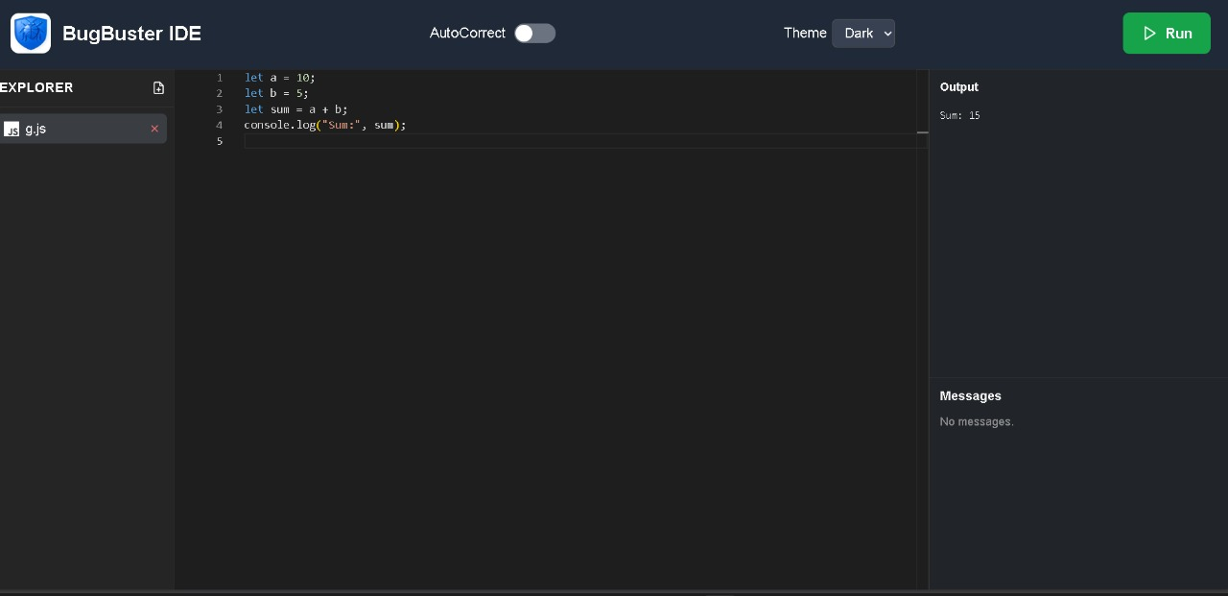

Slide 33
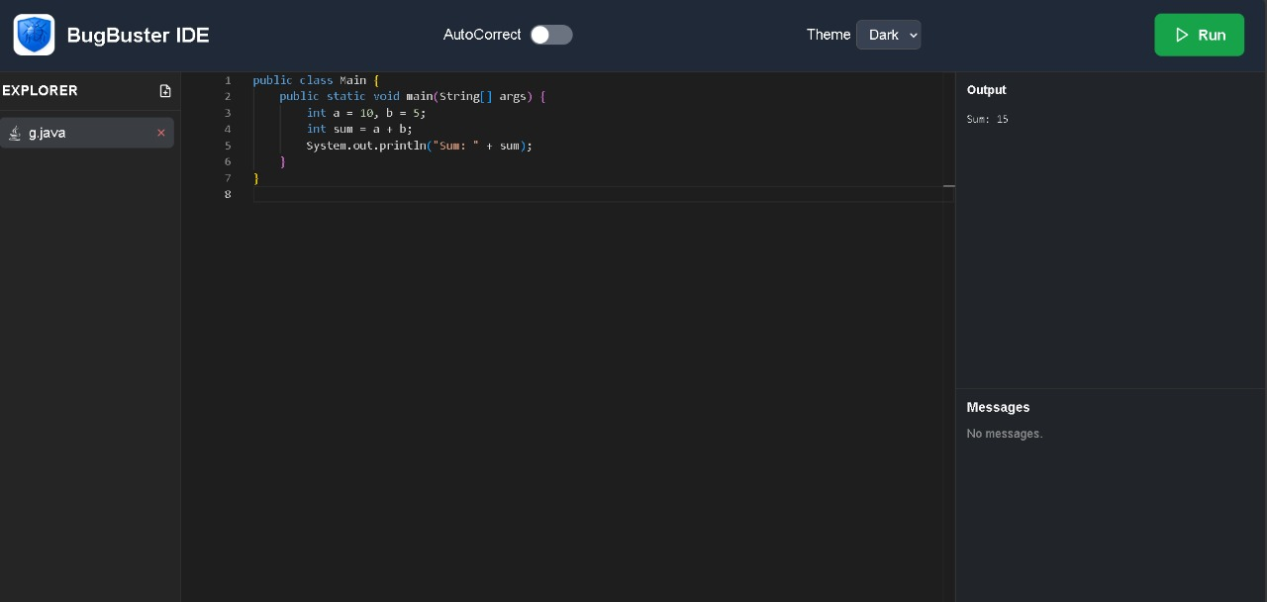

Slide 34
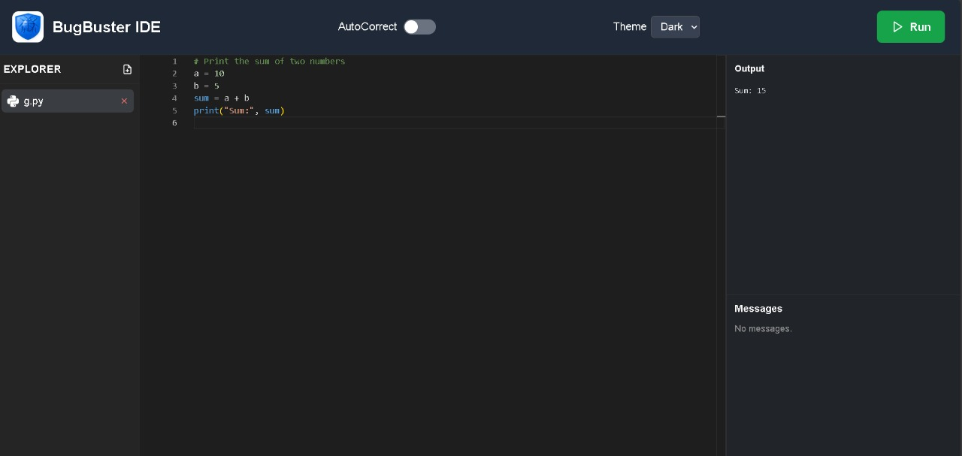

Slide 35
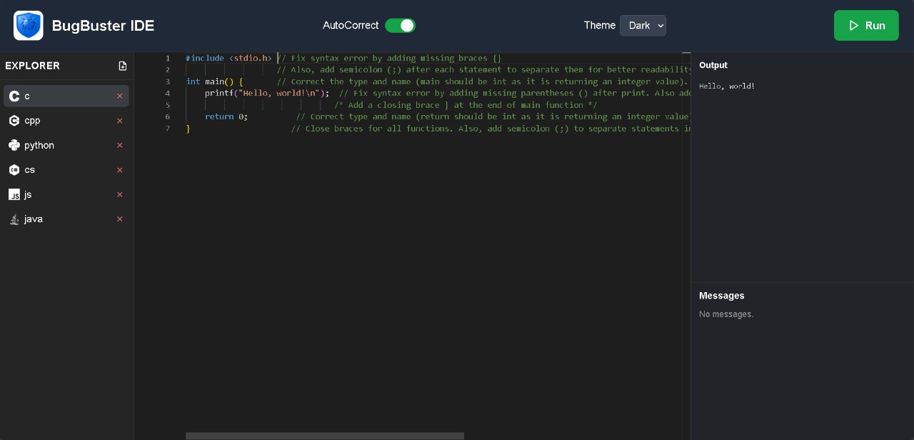

Slide 36
TEST CASES
Test Case 1: Missing Semicolon Detection (C/C++)
Input: printf("Hello")
Expected Output: Syntax Error – Missing semicolon
Actual Result: Error detected correctly
Status: Passed
Test Case 2: Indentation Error Detection (Python)
Input:if x > 5:print("Hi")
Expected Output: Indentation Error
Actual Result: Error detected with correct line number
Status: Passed

Slide 37
Test Case 3: Undeclared Variable Detection
Input: x = y + 1;
Expected Output: Semantic Error – Variable 'y' undeclared
Actual Result: Detected successfully
Status: Passed
Test Case 4: Unmatched Braces Detection
Input:{ int x = 10;
Expected Output: Syntax Error – Missing closing brace '}’
Actual Result: Correct error identified
Status: Passed
Test Case 5: Logical Error – Infinite Loop
Input:while(1){}
Expected Output: Warning – Infinite loop detected
Actual Result: Logical error detected
Status: Passed

Slide 38
FUTURE ENHANCEMENT
1. AI code review: Automatically evaluates code for quality, security, and performance.
2. Natural language refactoring: Transforms code using simple natural language instructions.
3. Visual debugging system:4. Shows program flow and errors with interactive visual tools.
4. Plugin ecosystem:Lets developers add custom extensions and features easily
5. Real-time collaboration:Enables multiple users to edit and debug code together.

Slide 39
CONCLUSION:
BugBuster IDE provides an intelligent and efficient environment for programming by integrating AI-based code correction, next-line and multi-language support. Its workflow ensures safe code execution using containerization while reducing debugging time and improving code quality. The system features a modern React frontend, FastAPI backend and LLM-based services that offer real-time assistance and scalability. Although additional improvements like collaborative editing, deeper semantic analysis and support for more languages can be added, the current implementation establishes a strong foundation for a smart, secure and user-centric IDE that enhances developer productivity and encourages innovation.

